Slide 1
Payload Progress Update
Science Team Meeting
02/01/2021
Phil Korngut
Yong J. Chong
For the Payload Team

Slide 2
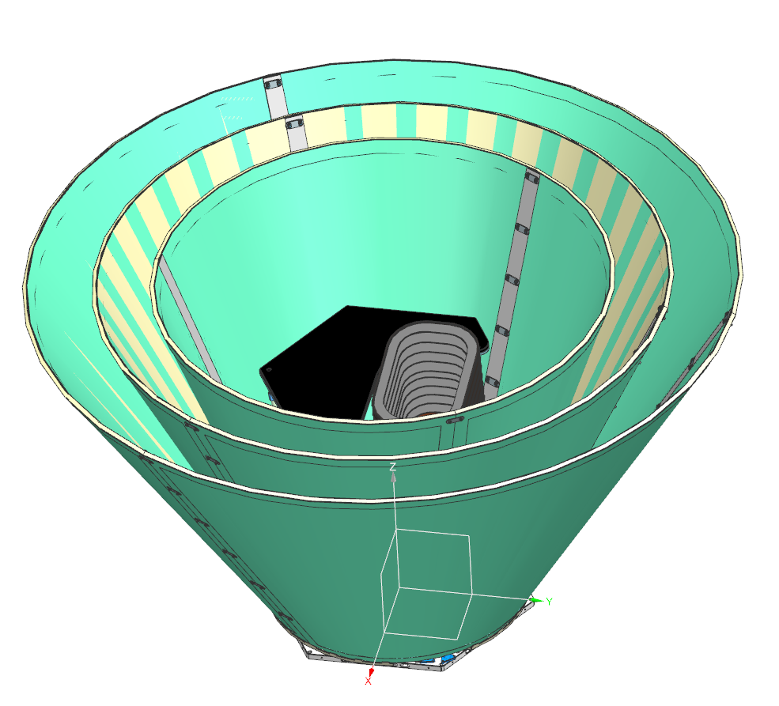
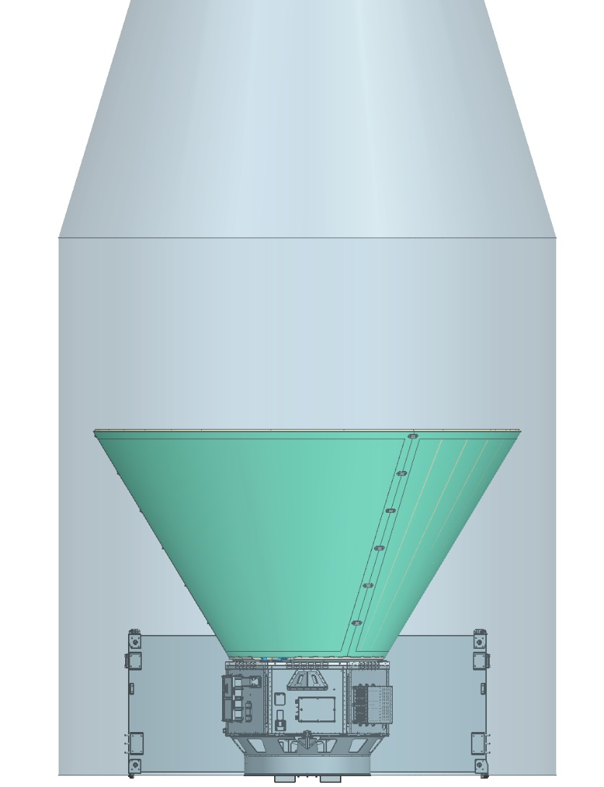
Solid Photon Shields
Kyle Chrystal, Doug Bolton and the thermal-mech team

Slide 3
Solid Photon Shields
Kyle Chrystal, Doug Bolton and the thermal-mech team

Slide 4
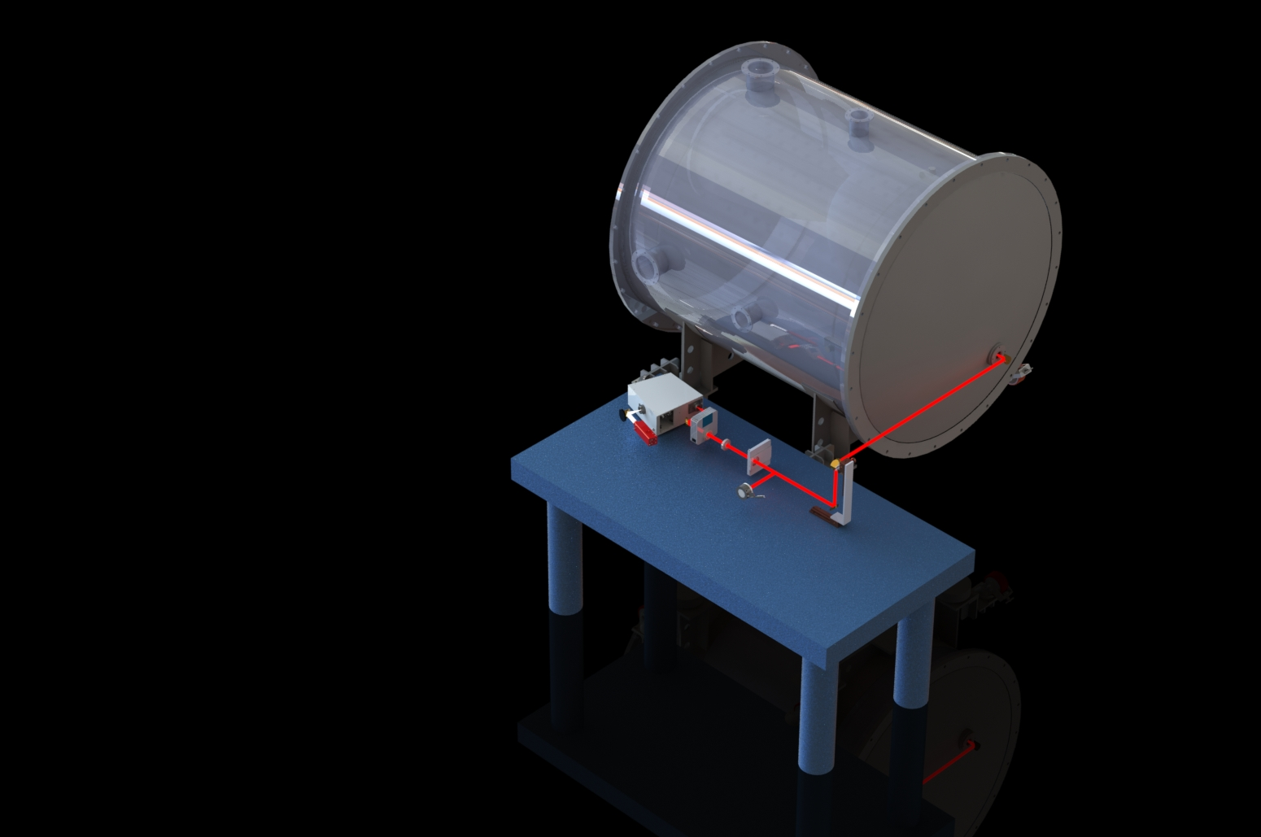
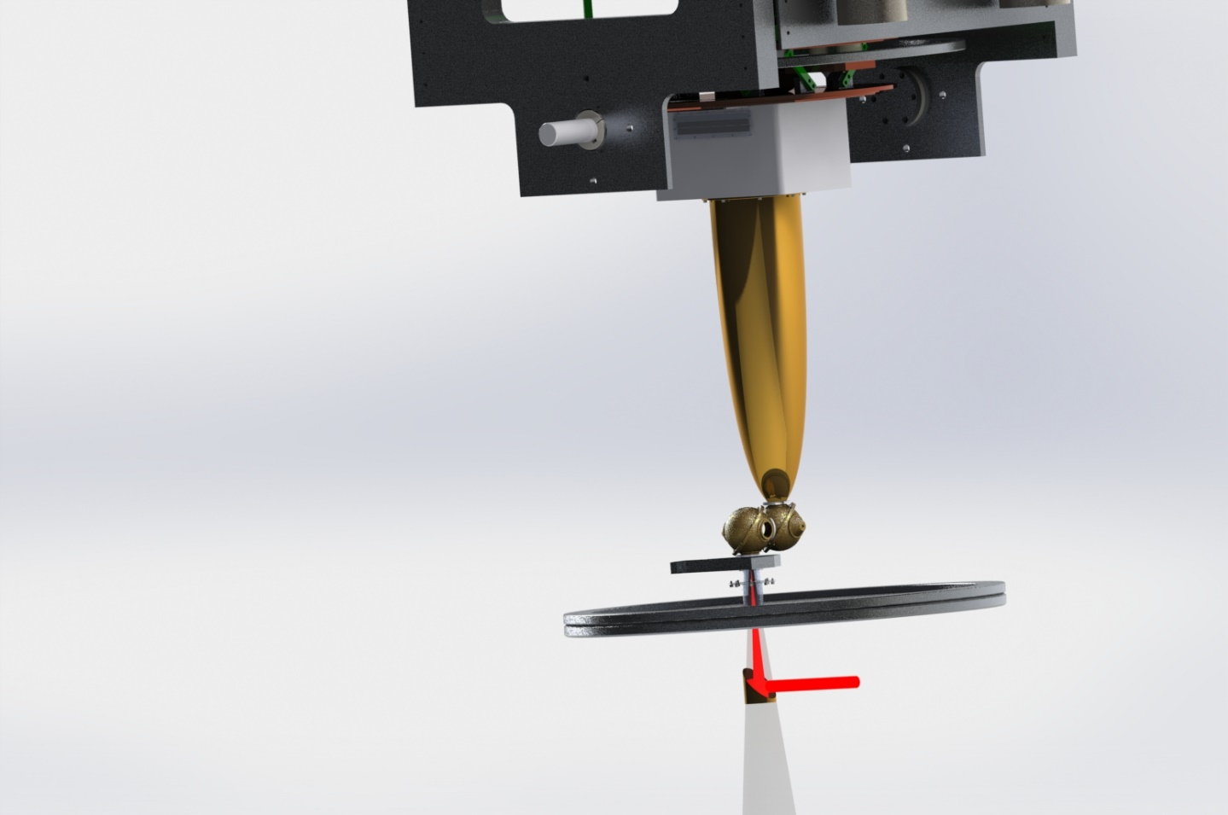
Spectral Calibration Setup
Phil Korngut
Howard Hui
KASI team

Slide 5
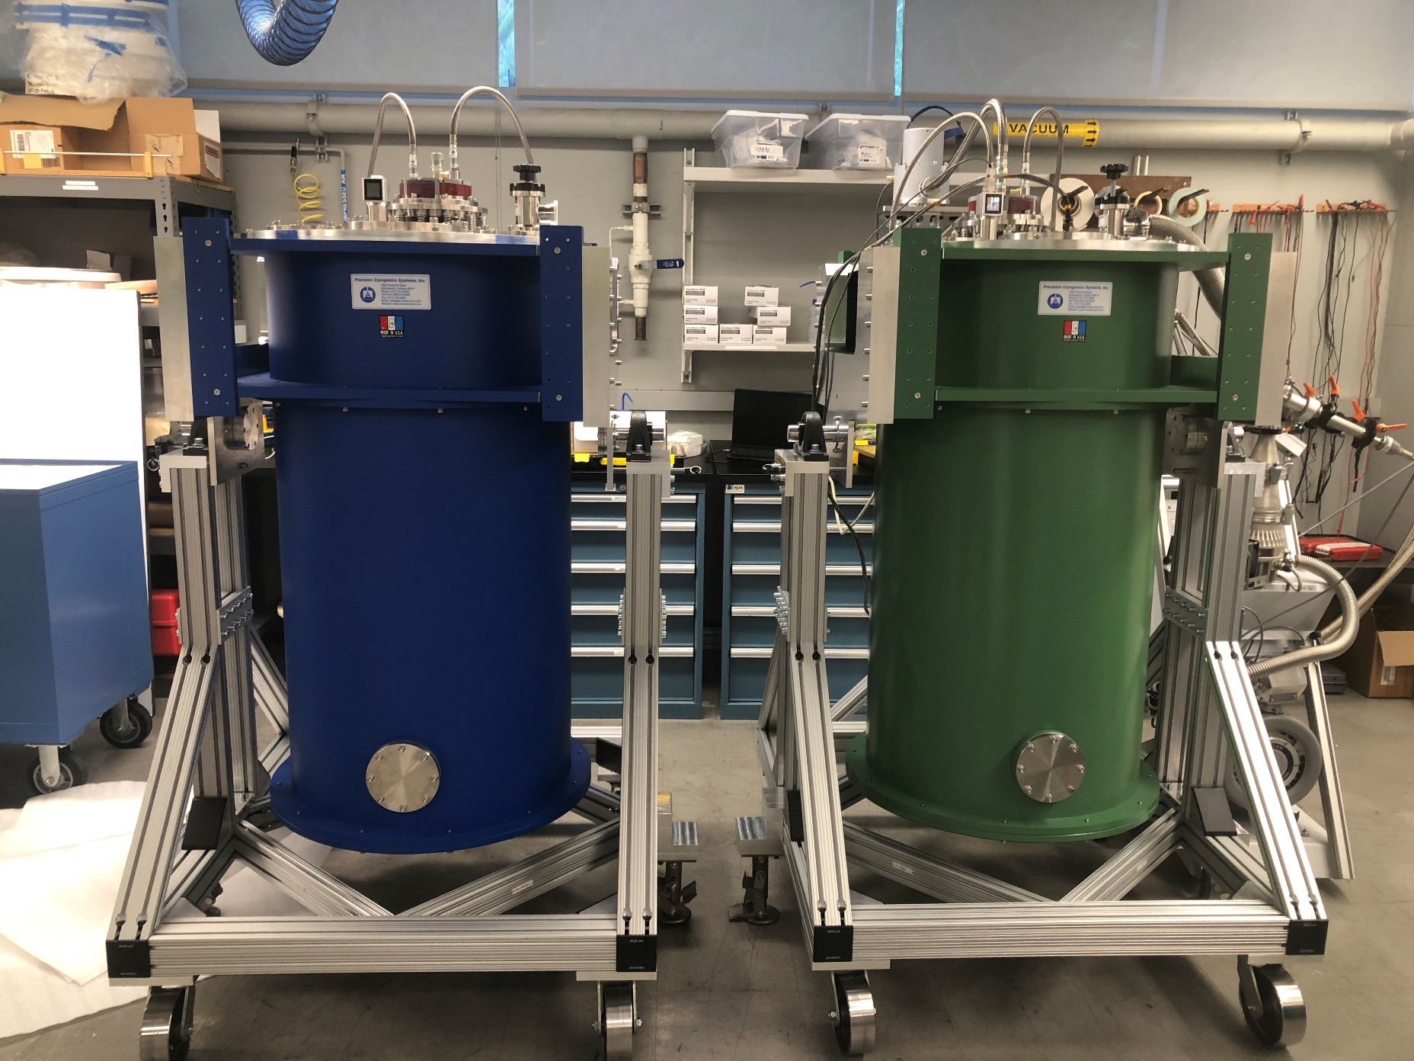
Caltech Test Dewars Ready to Roll
Hien Nguyen
Howard Hui
Steve Padin
Matt Hollister

Slide 6
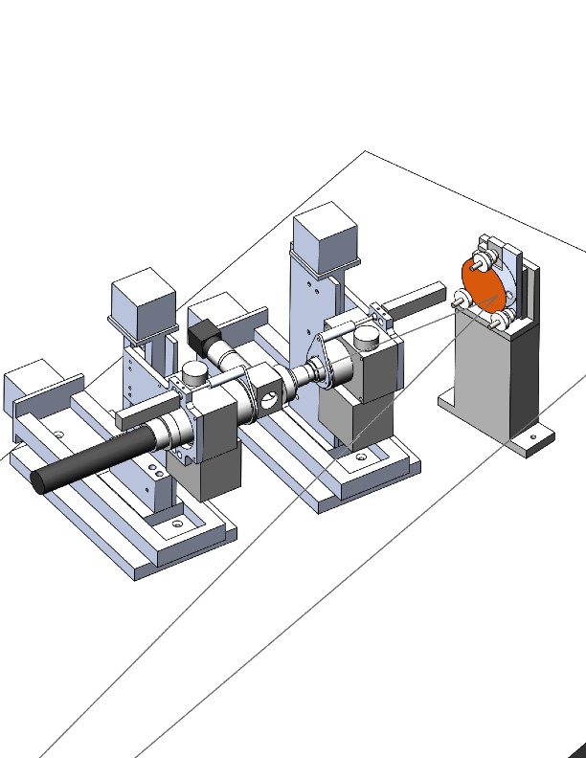
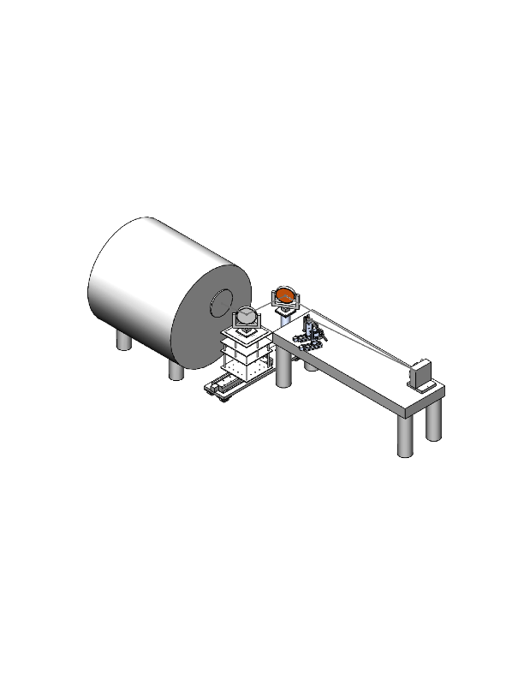
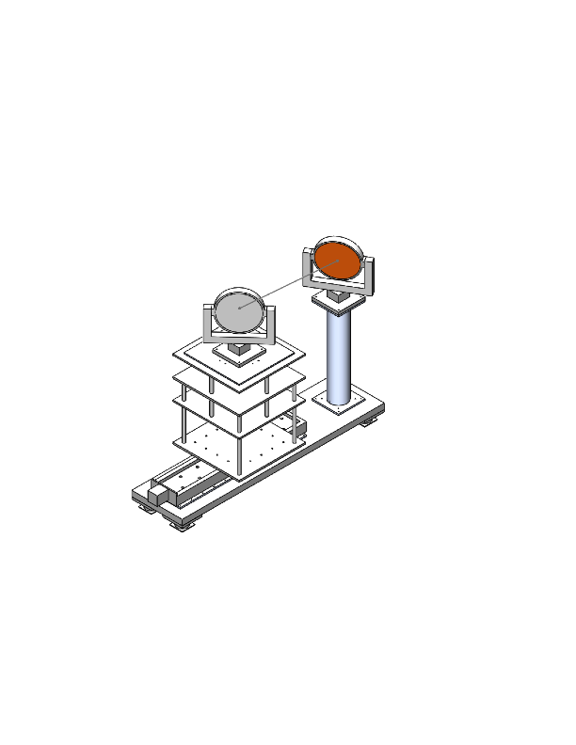
Focus Testing Setup
Steve Padin

Slide 7
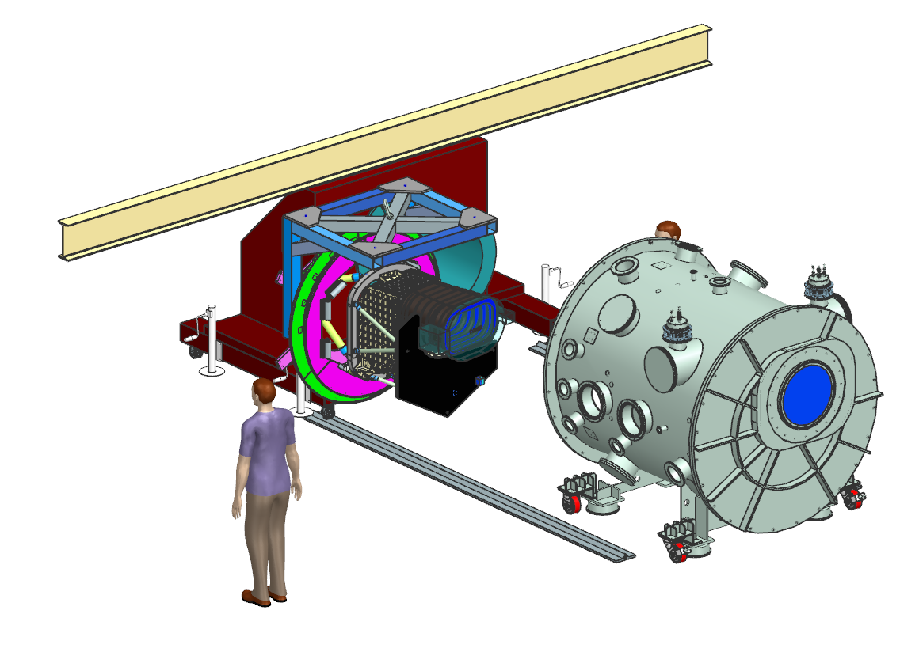
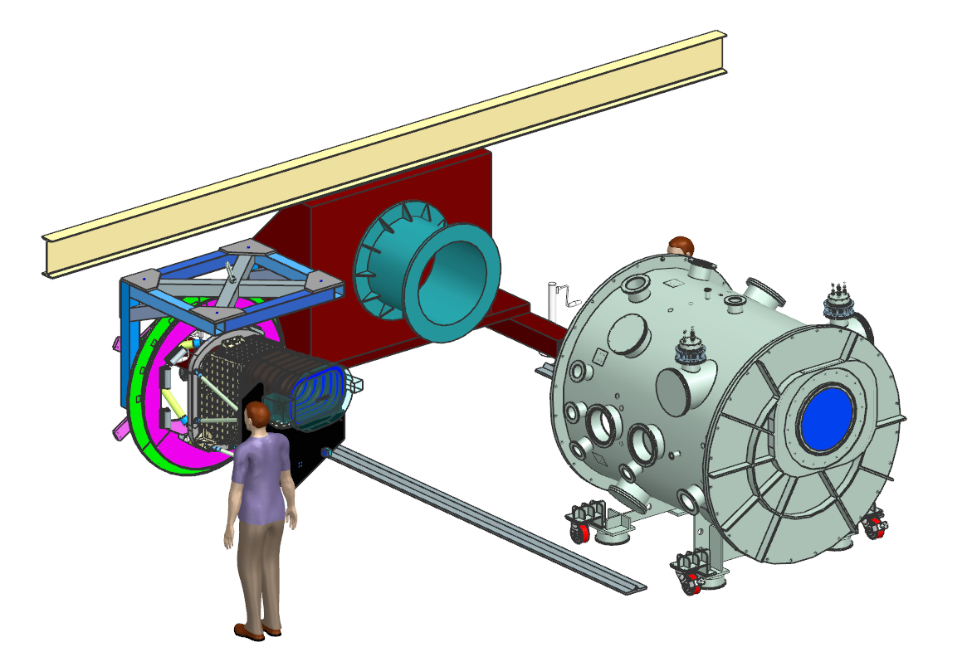
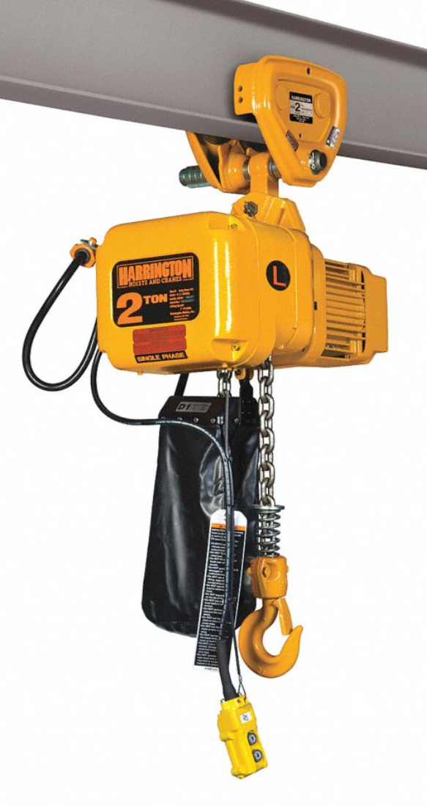
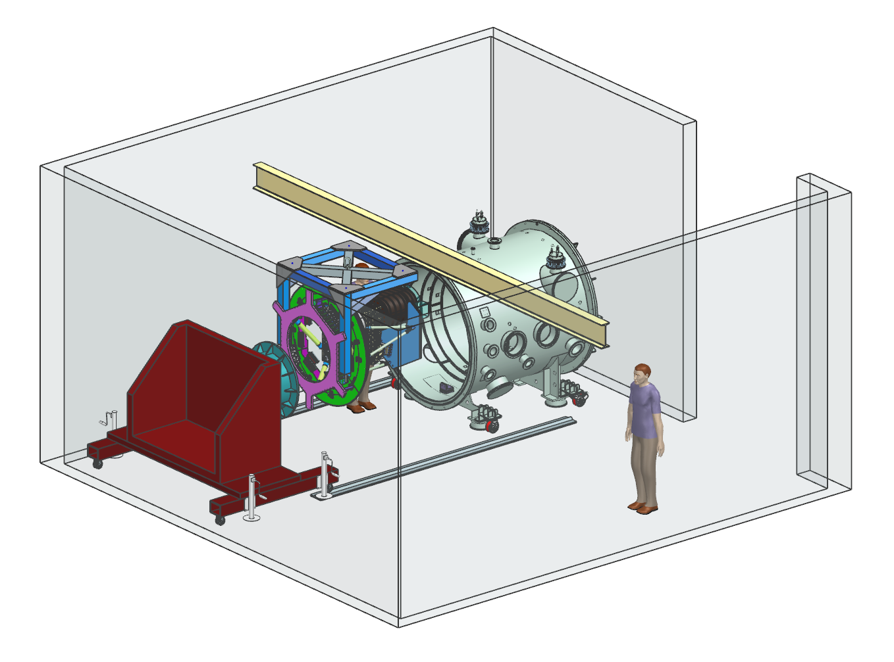
Loading the instrument in the KASI chamber

